Slide 1
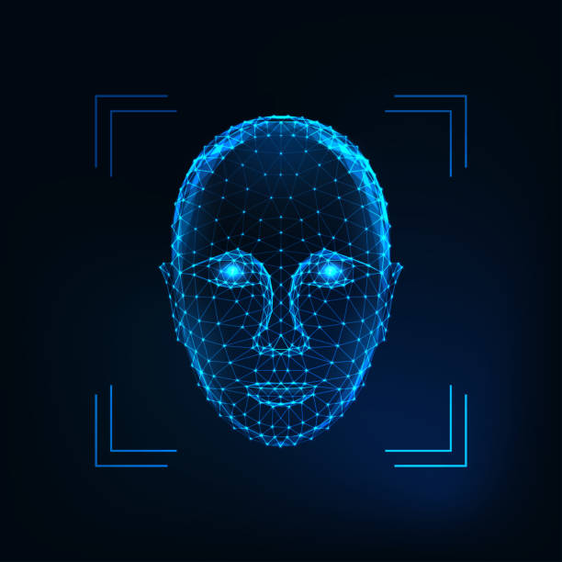
Face Detection and Recognition
-Siddhant Saini(210962160)
Department of Computer Science and Engineering- MIT Manipal

Slide 2
Abstract
Face detection and recognition plays a crucial role in computer vision and artificial intelligence. This project explores the fascinating field of enabling computers to identify and recognize faces in images or videos, achieved through the power of deep learning and neural networks. Our journey begins with an overview of the historical progression in face detection and recognition, from traditional techniques to the effectiveness of convolutional neural networks (CNNs). We also address challenges these systems encounter, such as variations in lighting and facial angles.
Moreover, we explore the extensive applications of face detection and recognition, which range from enhancing security measures to creating more interactive and personalized experiences. Additionally, we delve into the promising future trends in this field, including efforts to improve accuracy with reduced training data and ensuring that these systems can provide explanations for their decisions, promoting transparency and trust in their operation.

Slide 3
Introduction
In our increasingly digital world, the ability to interact with faces in images and videos has become essential. Face detection and recognition, pivotal within computer vision and artificial intelligence, offer a wealth of applications, from enhancing security to personalizing technology experiences.
This project takes you on a journey through the captivating realm of face detection and recognition. We'll explore key aspects like face detection in images, identifying facial features, real-time video interaction using webcams, the role of training data, and person identification based on facial features.
By the project's end, you'll have a deep understanding of the underlying technology and the ability to create your face detection and recognition system. Whether your goal is to bolster security, build intelligent applications, or simply have fun with technology, this project equips you with the necessary skills. Join us in this exciting exploration of the world of faces and the magic it brings to technology.

Slide 4
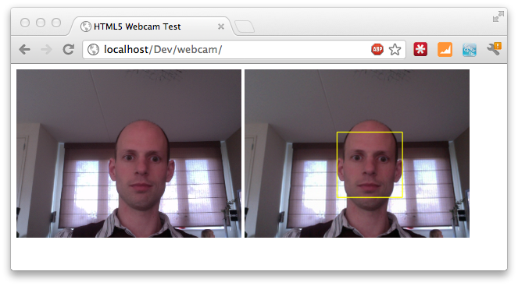
Face detection
To initiate our project, a crucial initial step was gaining the ability to access and analyze a live webcam video stream. This foundational capability was essential for the operation of our facial recognition system. With this live video input, we could actively engage with real-time visual data, ensuring that our approach was not limited to static images but adaptable to dynamic scenarios. This dynamic source enabled real-time execution of our face detection and recognition processes, setting the stage for subsequent phases of our computer vision project. The capability to access the live webcam video stream played a pivotal role in bringing our facial recognition system to life and making it applicable to a wide range of interactive and real-world applications.

Slide 5
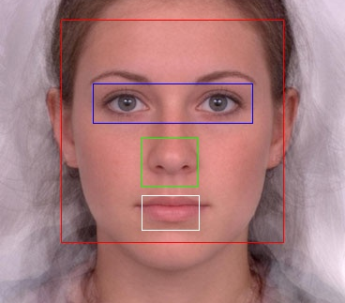
Detecting face, nose, eyes and mouth
After face detection, the next step often involves identifying specific facial features, like eyes, nose, and mouth. This enhances the robustness of face recognition systems.
Facial Landmark Detection: This involves pinpointing key points on the face, such as eye corners, nose tip, and mouth corners. Deep learning techniques, such as the facial landmark detection network, have been successful in achieving this

Slide 6
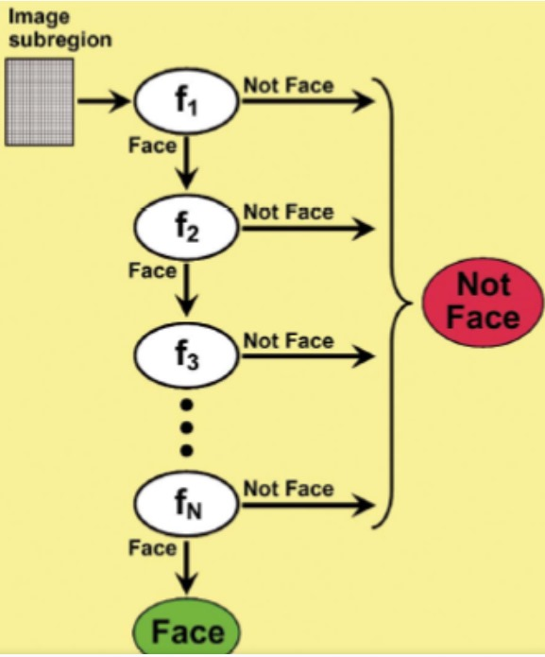
Cascade of classifiers
Cascade of Classifiers, such as the Haar Cascade Classifier, for face detection follows a sequential process:
Feature Extraction: Divide the image into smaller regions and calculate Haar-like features, representing pixel intensity differences.
Classifier Cascade: Multiple classifiers work sequentially, quickly rejecting non-face regions, ensuring efficiency and reducing false positives.
Thresholding and Classification: Each feature has a threshold; if below, it's "Not a Face"; if above, it's a potential face candidate.
Overall Decision: Combining decisions from all classifiers marks a "Face Detected." Haar Cascade Classifiers excel in real-time face detection and object recognition, known for their efficiency and accuracy in computer vision applications.

Slide 7
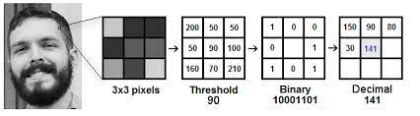
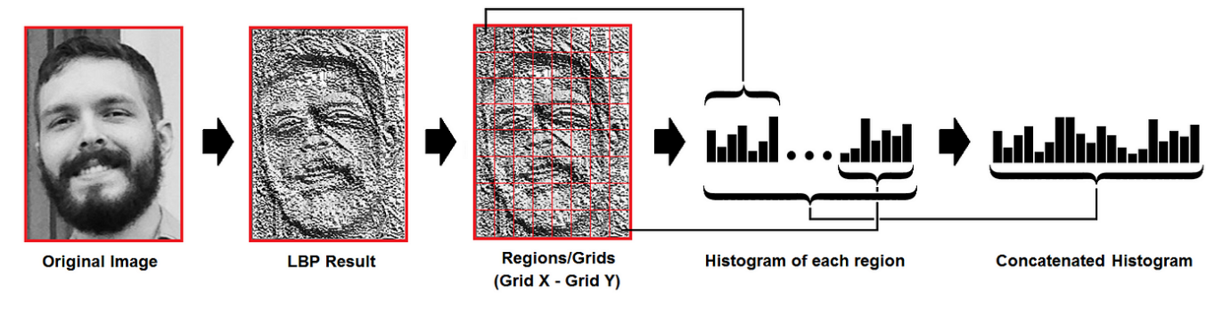
LBPH (Local Binary Pattern Histogram) Face Recognizer
Local Binary Pattern Histograms (LBPH) is a texture analysis technique used to detect faces. It operates by examining local pixel intensity patterns in an image. For each pixel, it compares its value with the surrounding pixels and encodes these relationships. These patterns are then used to construct a histogram for a given image or region. In the context of face detection, LBPH analyzes the unique texture characteristics of facial features. By creating a histogram of these patterns, it forms a distinctive representation of a face. This method's ability to capture facial texture details makes it particularly useful for recognizing faces, even under challenging conditions like varying lighting and pose, rendering it a valuable tool in the field of computer vision and face detection.

Slide 8
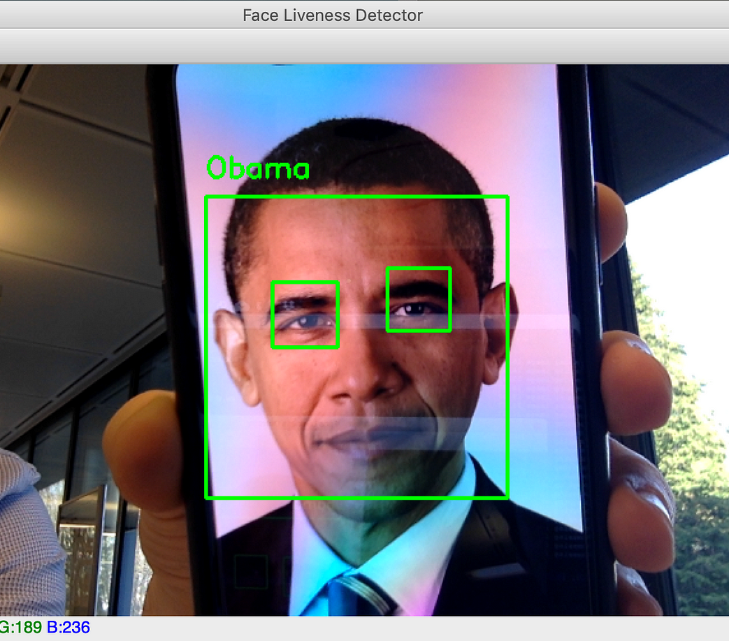
Methodology
1 .Reading live web cam video stream
2.Face detection using haar cascade
3.Detecting face, nose, eyes and mouth
4.Generating user dataset
5.Training classifier
6.Recognizing a person

Slide 9
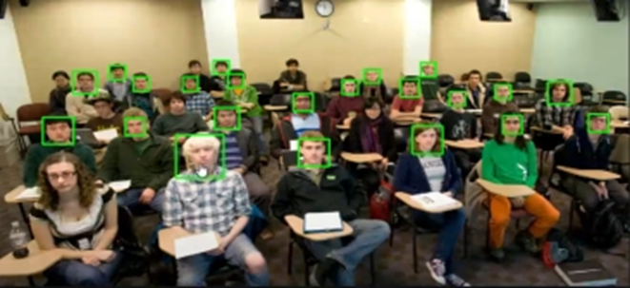
1)Reading live web-cam video stream
To initiate our project, a crucial initial step was gaining the ability to access and analyze a live webcam video stream. This foundational capability was essential for the operation of our facial recognition system. With this live video input, we could actively engage with real-time visual data, ensuring that our approach was not limited to static images but adaptable to dynamic scenarios. This dynamic source enabled real-time execution of our face detection and recognition processes, setting the stage for subsequent phases of our computer vision project. The capability to access the live webcam video stream played a pivotal role in bringing our facial recognition system to life and making it applicable to a wide range of interactive and real-world applications.
Scale factor

Slide 10
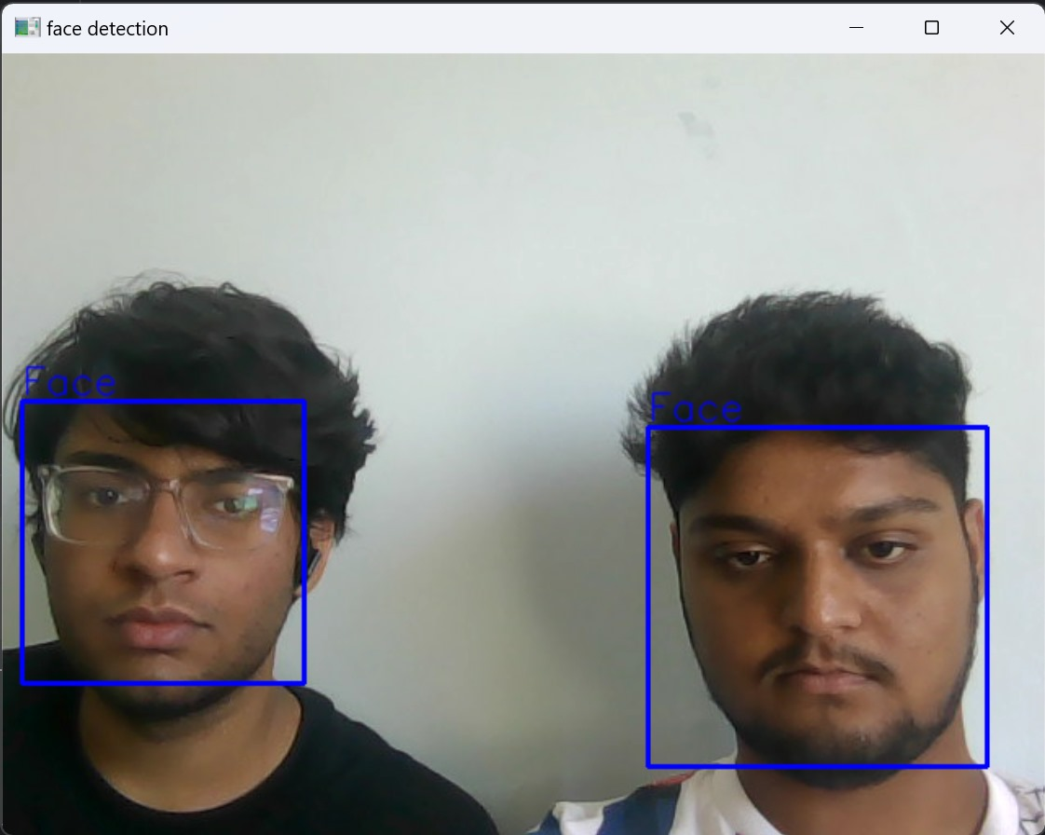
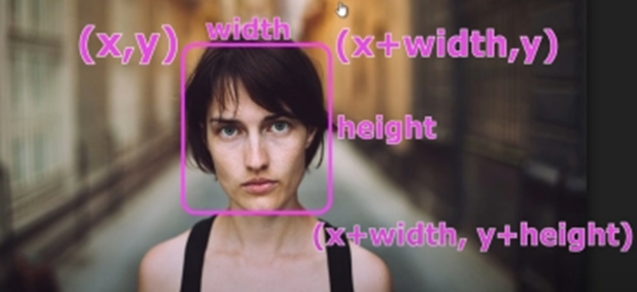
2)Face detection using Haar Cascade
In the initial phase of our computer vision project, we initiated the process by activating the webcam and executing the program. Our primary objective at this stage was to create a boundary around the detected faces within the camera feed. To accomplish this, we employed the Haar Cascade Classifier, specifically the 'haarcascade_frontalface_default' Cascade, renowned for its effectiveness in face detection. This classifier allowed us to pinpoint the position of faces within the frame, defining the top-left coordinates (x, y) and the bottom-right coordinates (width, height) of each detected face. This step laid the foundation for our subsequent image analysis and processing.
Coordinates
Face detection

Slide 11
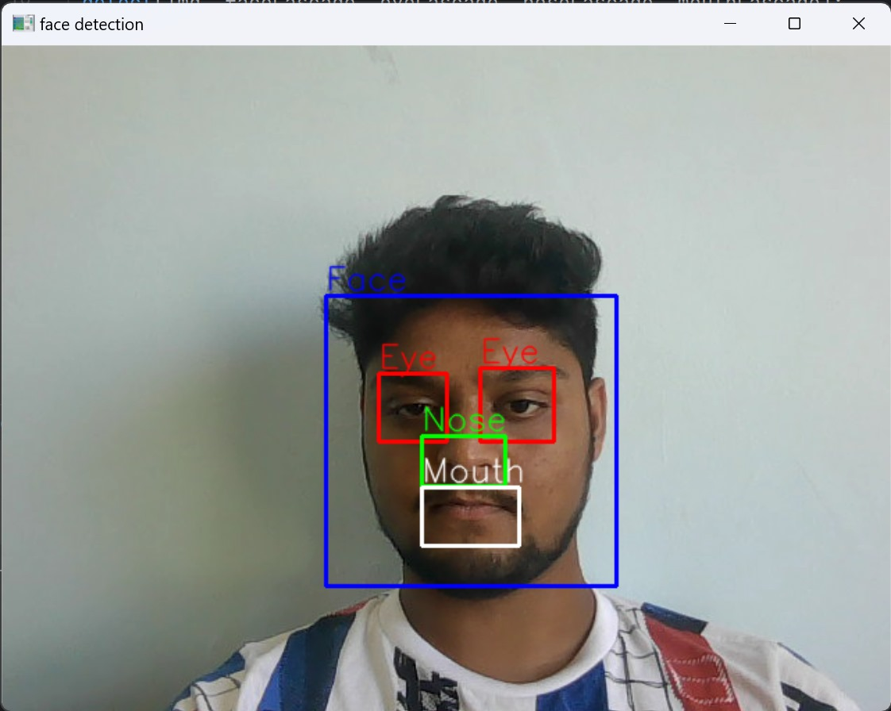
3)Detecting Face, Nose, Eyes and Mouth
The subsequent phase of our project, our focus shifted towards isolating and extracting the detected face from the larger context of the image. Since the position of the face changed dynamically as we moved the camera or as individuals within the frame moved, this step was essential for ensuring accurate feature analysis. After successfully cropping the face, we continued with our analysis by detecting specific facial features, namely the eyes, nose, and mouth. To accomplish this, we leveraged a series of Haar Cascade Classifiers tailored for each of these features. We employed the 'haarcascade_eye.xml' classifier to identify and delineate the eyes, for the detection of the nose, and 'mouth.xml' for the mouth. These classifiers were instrumental in creating boundaries around these vital facial components, paving the way for further analysis and applications in our computer vision project.
Face, Nose, Eyes detection

Slide 12
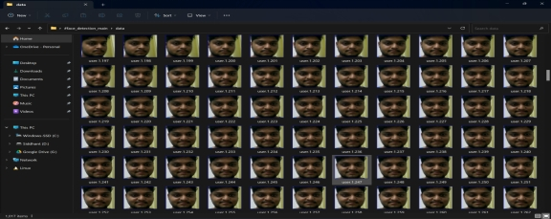
4)Generating dataset
In the following phase of our project, we embarked on the crucial task of data collection and preparation to facilitate the training of our classifiers. To achieve this, we established a dedicated data directory within our system. This data directory served as the repository for our custom-generated dataset, which was essential for training our classifiers to recognize unique individuals. Each user was assigned a distinct user ID, denoted as user_id=1, user_id=2, and so forth, and this information was meticulously organized within the data directory. Our data collection process was seamlessly integrated into the program's execution and the webcam's activation. As soon as the program was launched and the webcam was turned on, the dataset generation process commenced. This automated data generation process was designed to capture approximately 500 images of individuals, ensuring a diverse and robust dataset for subsequent classifier training.
User generated dataset

Slide 13
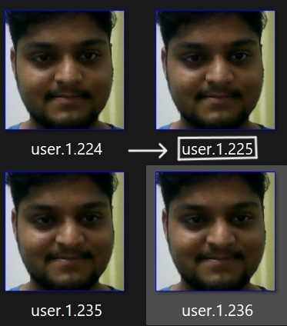
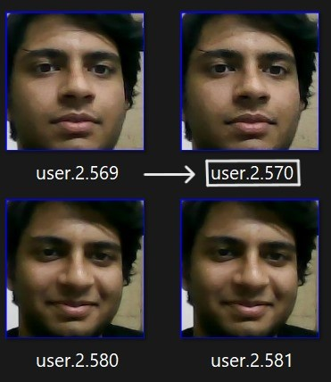
5)Training classifier for face recognition
In this phase of our computer vision project, we employed the Python Imaging Library (PIL) to import the images from our custom dataset. PIL, also known as the Python Imaging Library, equipped our Python interpreter with essential image editing capabilities, ensuring that our dataset was well-prepared for training and analysis. The heart of our project lay in training the classifier to recognize individuals within the dataset. We accomplished this task using a dedicated Python script, 'classifier.py.' This script was responsible for processing the imported images and generating a trained model file named 'classifier.yml.' The classifier was configured to leverage the Local Binary Pattern Histogram (LBPH) Face Recognizer, a powerful technique that excels in facial recognition tasks. The resulting 'classifier.yml' file encapsulated the knowledge acquired during the training process, enabling our computer vision system to identify and distinguish individuals based on facial features.
user_id-1
user_id-2

Slide 14
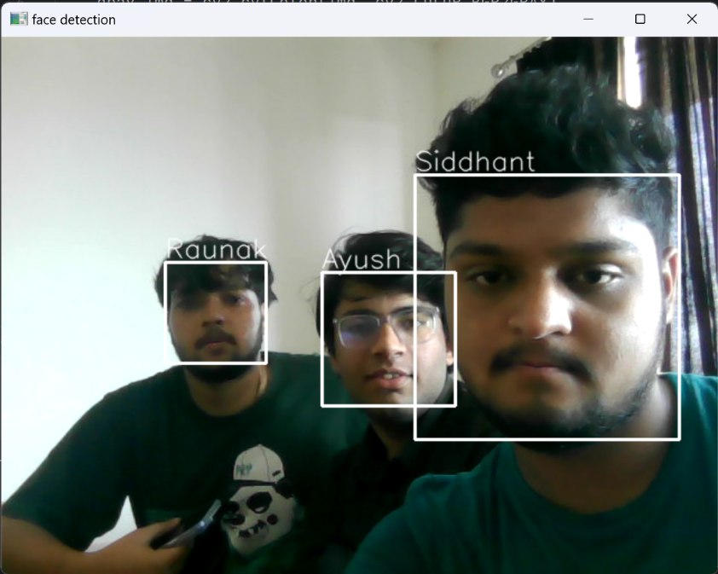
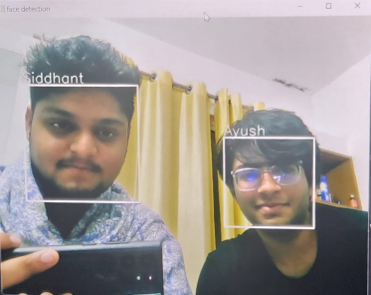
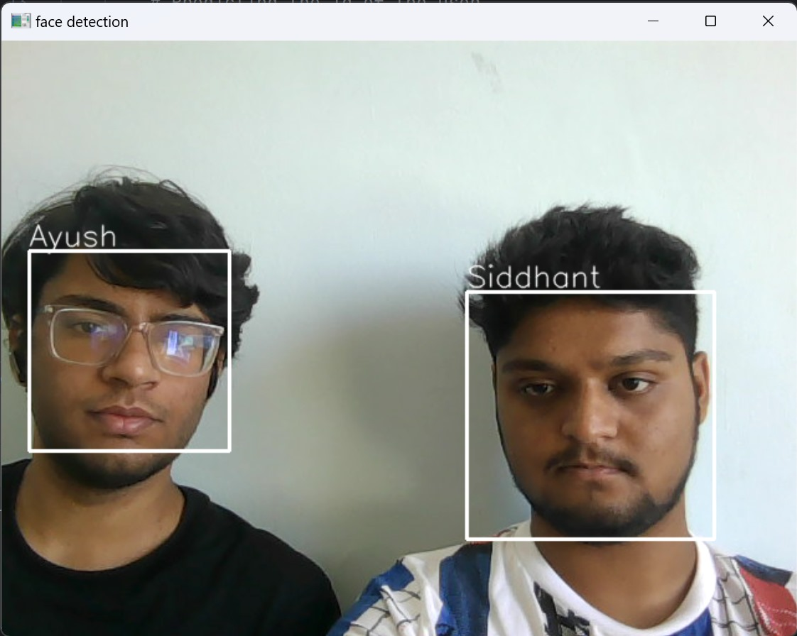
6)Recognizing a person
In the project's concluding phase, we successfully deployed a facial recognition system capable of accurately identifying and authenticating users based on their unique facial features and associated user IDs. This advanced functionality not only bolstered security but also delivered tailored, personalized experiences to individuals interacting with our system. This practical application demonstrated the project's real-world effectiveness, highlighting its potential to enhance user-specific interactions.
Multiple user face recognition

Slide 15
Results and Discussion
In our experimental setup, the facial recognition system excelled. Haar Cascade Classifiers effectively detected facial features in the live video stream, while the Local Binary Pattern Histogram (LBPH) Face Recognizer ensured precise person recognition. With a dataset of around 500 diverse user images, our system achieved robust training and high recognition accuracy. Real-time webcam interaction showcased its adaptability to dynamic scenarios.
The successful implementation of Haar Cascade Classifiers and LBPH underscored our approach's effectiveness. Automated dataset generation and organization streamlined training, making it adaptable. However, real-world challenges like lighting variations and user pose must be considered.

Slide 16
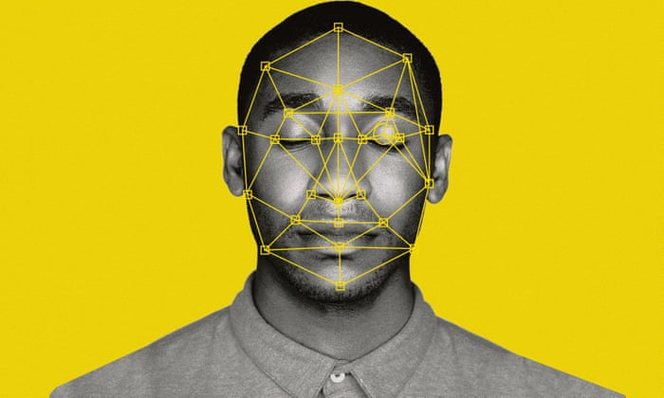
Conclusion
Our facial recognition system, rooted in Haar Cascade Classifiers and the LBPH Face Recognizer, holds significant promise for real-world applications. It boasts high accuracy in individual recognition based on facial features, making it suitable for security, access control, and personalized user experiences. The automated dataset generation and user-specific data directory organization enhance its adaptability.

Slide 17
Future work
Advance AI and deep learning for more robust and accurate face detection, especially in challenging conditions.
Explore face recognition from non-visible spectra (e.g., thermal or infrared) for enhanced security.
Research explainable AI and fairness in face recognition to address privacy and bias concerns.
Investigate cross-modal face recognition using multiple sensors for comprehensive recognition

Slide 18
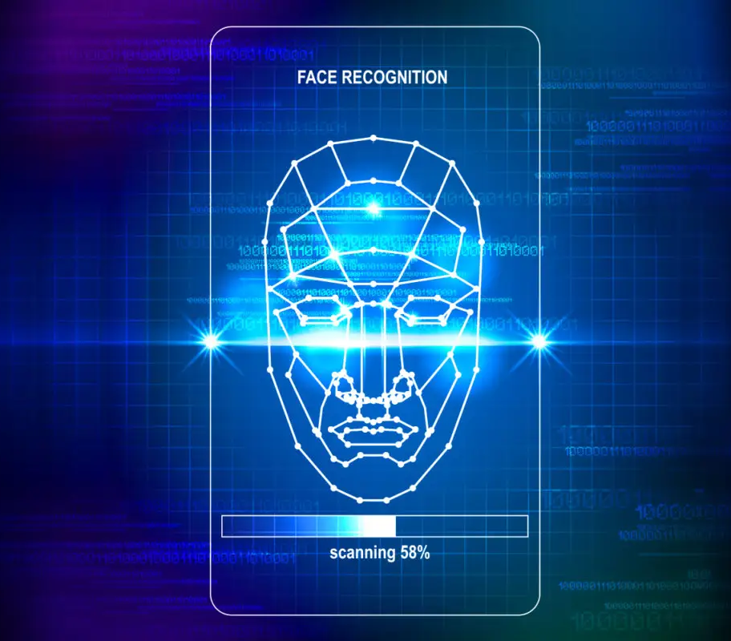
Applications
Our facial recognition system has broad applications such as:
Security and Attendance: Access control and identity verification.
Personalized Experiences: Tailored user interactions in smart systems.
Healthcare: Patient identification and monitoring.
Retail: Customer recognition for improved service.
Entertainment: Enhanced gaming and virtual experiences.

